Slide 1
Instructions for Building an Entry Quad Chart:
Simply copy the format/fonts, etc. for the Entry Quad in the illustrations provided on the following two slides. The first slide is an example Entry Quad; the second is a blank Entry Quad template. What follows are explanations of the primary regions of the Entry Quad chart.
Header: The top of the Entry Quad chart should have the Title of the task, in the first line, and the “PI Name, Institution” in the second line. Both of these are above the red and blue lines in the area where the NASA logo is located. The font throughout the Entry Quad is “Comic Sans”.
Top Left Quadrant: The Objective (what the task will do) in bullet format.
Top Right quadrant: A representative illustration of the technology, at the initial stage of the task.
Bottom Right Quadrant: Key Milestones with Dates (when) for accomplishment of the task in the format of “Milestone One Mo/Yr” (for example, use 03/12 for March, 2012). At the bottom, center of this quadrant, the entry TRL for the technology in the format TRLin = m
Bottom Left Quadrant: Approach (how) in bullet format outlining how the task will be accomplished. This quadrant also lists any Co-Is/Partners in the format “First initial. Last name, Organization” (R. Smith, University of Maryland)
Footer: Provide the date the chart was created in Mo/Yr format (for example, use 03/12 for March, 2012) on the lower left of the slide, below the double blue lines.
Page 2 of this presentation contains an example slide and page 3 contains a blank template.

Slide 2

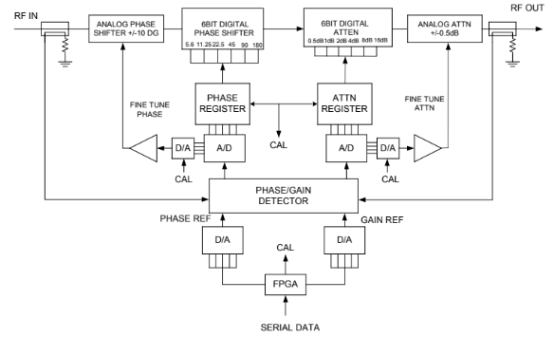
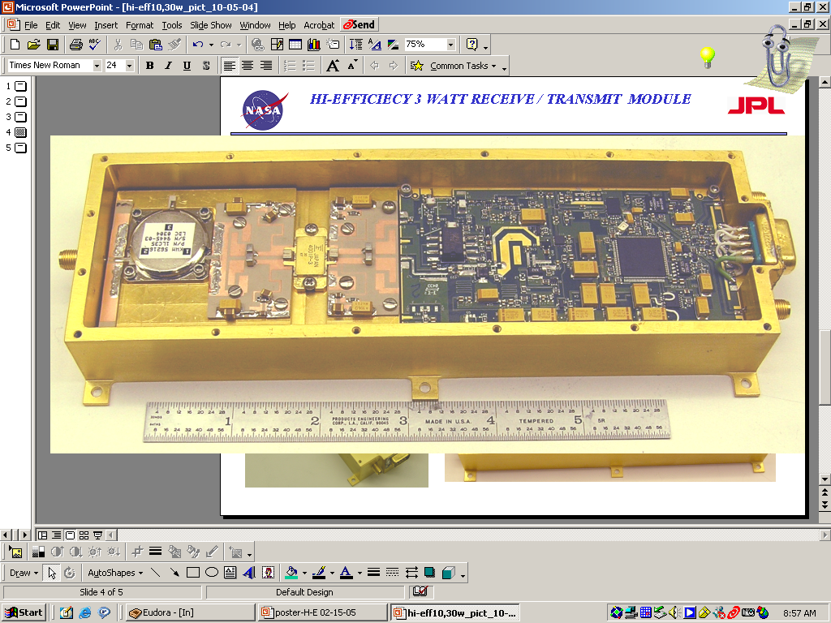

Adaptive Self-Correcting T/R Module
PI: Wendy Edelstein, JPL
Objective
Develop a practical and low cost adaptive L-band T/R module with integrated calibrator for use in phase-stable array antennas for interferometric synthetic aperture radar (InSAR) applications.
Performance goals are <1 deg absolute phase stability and <0.1 dB absolute amplitude stability over temperature.
Technologies include high efficiency L-band T/R module; integrated phase/amplitude detector; closed-loop detection and correction circuitry.
Closed-Loop Calibration Scheme
High-Efficiency L-band T/R module to be modified with integrated calibrator
EXAMPLE SLIDE
Approach:
Key Milestones
Modify an existing high-efficiency L-band T/R module with built-in calibrator by:
  Developing a stable closed-loop amplitude and phase detector circuit.
  Integrating the calibrator circuit into the L-band T/R module.
  Characterizing performance over temperature to demonstrate ability to self-correct for variations in insertion phase or amplitude.
Requirements, architecture, design 7/06
Breadboard demo (TRL 5) 1/07
Build T/R with integrated calibrator 7/07
Prototype validation (TRL 6) 1/08
CoIs: Constantine Andricos, Gregory Sadowy, JPL
TRL_{in} = 4
04/07

Slide 3
TITLE HERE
PI: Name Here, Organization Here
Objective
Objective Here
Image / Picture Here with Caption
Approach:
Key Milestones
Approach Here
Milestone Here Mo/Yr
Milestone Here Mo/Yr
Milestone Here Mo/Yr
Milestone Here Mo/Yr
Milestone Here Mo/Yr
CoIs: CO-Is / Partners Here
TRL_{in} = ?
Mo/Yr

